Slide 1
Introduction to Python Programming

Slide 2
Contents
Introduction
Environmental setup
Basic Syntax
Data Types
Operators
Decision Making
Loops
Numbers
Strings
File I/O
numPy

Slide 3
What is Python?
Python is a widely used high-level, general-purpose, interpreted, dynamic programming language
Available under the GNU General Public License (GPL)
Python supports multiple programming paradigms, including object-oriented, imperative and functional programming or procedural styles.
It features a dynamic type system and automatic memory management and has a large and comprehensive standard library.
Huge community pypi (Python Package Index) containing 92K + packages
Python Features
Easy-to-learn
Easy-to-read
A broad standard library
Databases
GUI Programming
Scientific Calculations

Slide 4
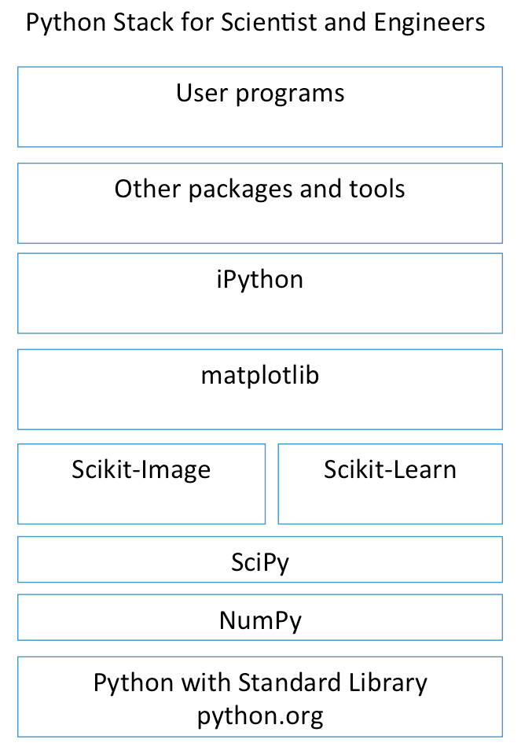
Python for Science and Engineering
Python by itself is not that useful for S&E
Many add-ons and extensions have been created to allow python to work for S&E’s, web development, big data processing, and other software stacks”.
iPython is now called Jupyter

Slide 5
Getting Python
Most up-to-date version is available on the official website of Python https://www.python.org/
It is available for a wide variety of platforms.

Slide 6
Getting Python
Various ways to start python:
1. Immediate Mode:
Enter python command to get following prompt
>>>
The python interpreter is ready for input
Eg. type 4+7 and press enter to get the output
To exit this mode type exit() or quit() and press enter.

Slide 7
Getting Python
Various ways to start python:
2. Script Mode:
Used to execute Python program written in a file called a script
Python scripts have the extension .py
To execute this file in script mode we simply write python helloWorld.py at the command prompt

Slide 8
Getting Python
Various ways to start python:
3. Integrated Development Environment (IDE):
IDE is a piece of software that provides useful features like code hinting, syntax highlighting and checking, file explorers etc. to the programmer for application development
IDLE is the IDE installed along with the Python programming language and is available from the official website. Others are
Jupyter notebook
Spyder
PyCharm
PyScripter
PythonWin
Anaconda is one of the most popular Python data science platform

Slide 9
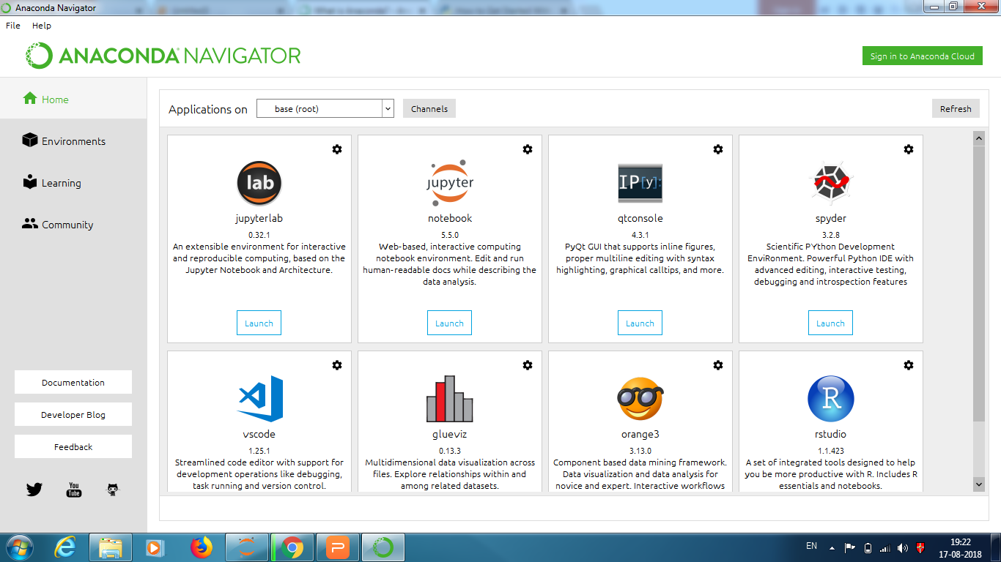
The Anaconda Navigator

Slide 10
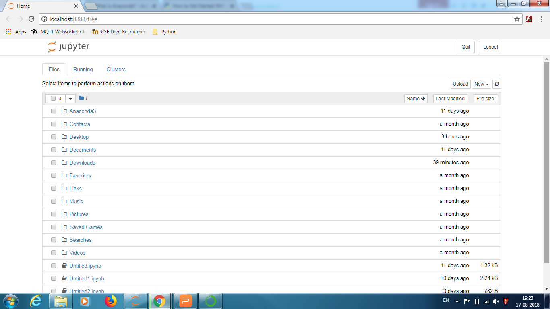
Jupyter

Slide 11
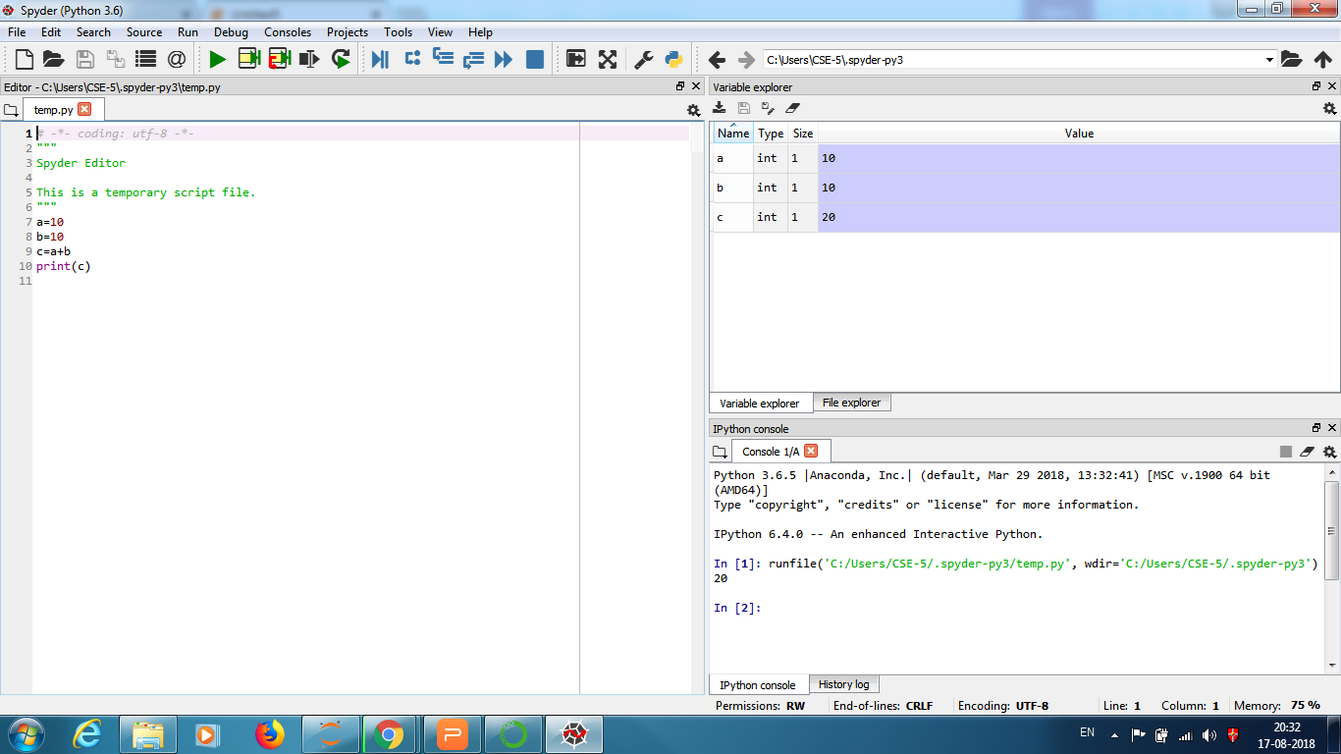
Spyder

Slide 12
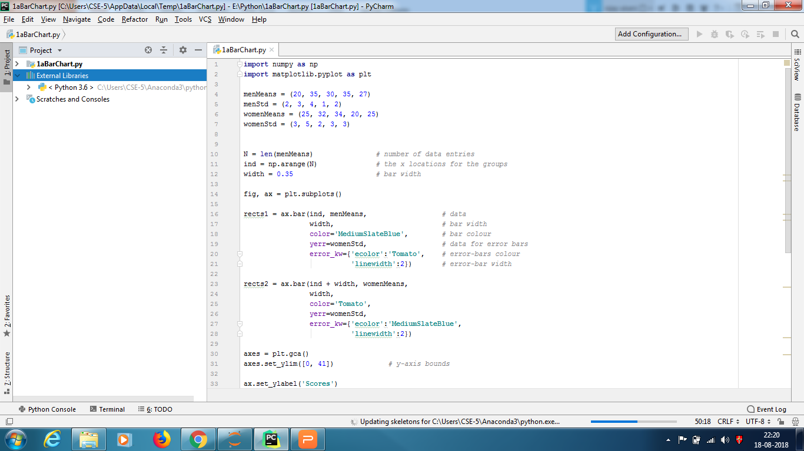
PyCharm

Slide 13
Installing Packages
You can install packages from the Anaconda terminal using the command:
conda install <name of package>
For example, Seaborn is a package for Statistical Data Visualization.
conda install seaborn
piserial is a package for communication with serial devices.
conda install piserial

Slide 14
Running Python
Type following code in any of IDE/python prompt
>>> print("Hello world!")
Few more examples
>>> 5+7

Slide 15
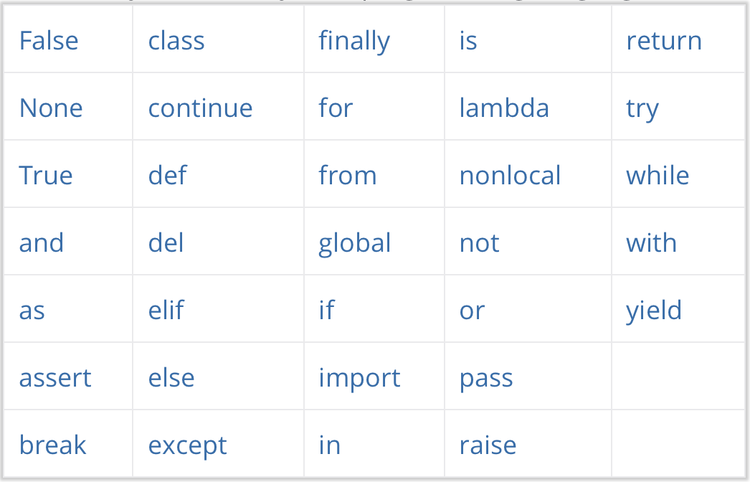
Python Keywords

Slide 16
Python Identifiers
Identifier is a name used to identify a variable, function, class, module or other object
An identifier starts with a letter A to Z or a to z or an underscore (_) followed by zero or more letters, underscores and digits (0 to 9)
Python does not allow punctuation characters such as @, $, and % within identifiers
Identifiers are case sensitive

Slide 17
Python Indentation
In most other programming languages the indentation in code is for readability only, in Python the indentation is very important
Python uses indentation to indicate a block of code
Following code creates a block under if statement
if 5 > 2:
print("Five is greater than two!")
While this code generates error
if 5 > 2:
print("Five is greater than two!")

Slide 18
Comments and help
Python Comments:
Comments start with a #, and Python will render the rest of the line as a comment
#This is a comment.
print("Hello, World!")
Docstrings
"""This is a
multiline docstring."""
Help in Python: help(topic)
If no argument is given, the interactive help system starts on the interpreter console. If the argument is a string, then the string is looked up as the name of a module, function, class, method, keyword, or documentation topic, and a help page is printed on the console.

Slide 19
Printing in Python
Syntax: print(value, ..., sep=' ', end='\n', file=sys.stdout, flush=False)
print("Hello World") #Hello World
a=5
b=2
print(a) # 5
print(a, b) # 5 2
print(a) # 5
print(b) # 2
print('V','S','U', sep=”, \t”, end=”X”) #V, S, UX

Slide 20
Printing in Python
print("a={0}".format(a)) #a=5
print("a={0} and b={1}".format(a, b)) #a=5 and b=2
print("a={1} and b={0}".format(a, b)) #a=2 and b=5
print(“a={} and b={}”.format(a, b)) #a=5 and b=2 #auto field numbering
print("bin={0:b}, oct={0:o}, hex={0:x}".format(12)) #bin=1100, oct=14, hex=c
print("bin={0:b}, oct={1:o}, hex={1:x}".format(12,10)) #bin=1100, oct=12, hex=a
print("bin={:b}, oct={:o}, hex={:X}".format(12,10,10)) #bin=1100, oct=12, hex=A

Slide 21
Printing – Padding & Alignment
print("a={0:d} and b={1:d}".format(a, b)) #a=5 and b=2
print("a={0:3d} and b={1:5d}".format(a, b)) #a= 5 and b= 2
print("a={0:>3d} and b={1:>5d}".format(a, b)) #a= 5 and b= 2
print("a={0:<3d} and b={1:<5d}".format(a, b)) #a=5 and b=2
print("a={:<{}d} and b={:<{}d}".format(a,3,b,5)) #???
print("a={0:03d} and b={1:05d}".format(a, b)) #a=005 and b=00002
print("a={0:^3d} and b={1:^5d}".format(a, b)) #a= 5 and b= 2
print(“a={:f}".format(123.4567898)) #a=123.456790
print("a={:8.3f}".format(123.4567898)) #a= 123.457

Slide 22
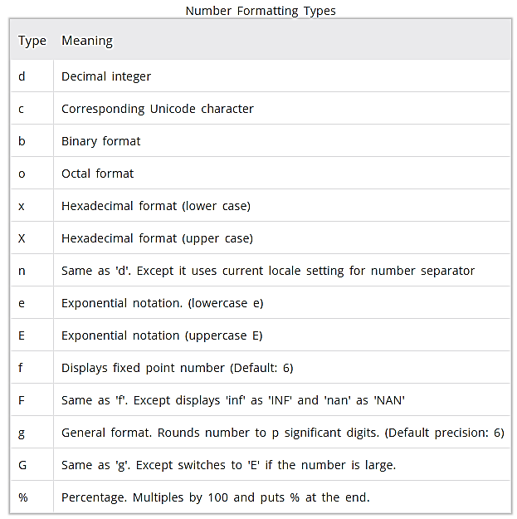
Number Formatting Types

Slide 23
Standard Data Types
Python has five standard data types −
Numbers
String
List
Tuple
Dictionary

Slide 24
Standard Data Types
Numbers
int
All integers in Python3 are represented as long integers. Hence there is no separate number type as long.
Integers in Python 3 are of unlimited size.
float
Complex
A complex number consists of an ordered pair of real floating-point numbers denoted by x + yj, where x and y are the real numbers and j is the imaginary unit.

Slide 25
Standard Data Types
Numbers
Examples
int | float | complex
10 | 0.0 | 3.14j
100 | 15.20 | 45.j
-786 | -21.9 | 9.322e1-36j
0o70 | 32.3e18 | .876j
-0o470 | -90. | -.6545+0J
-0x260 | -32.54e100 | 3e1+26J
0x69 | 70.2E-12 | 4.53e1-7j

Slide 26
Standard Data Types
Strings
Strings in Python are identified as a contiguous set of characters represented in the quotation marks.
Python allows for either pairs of single or double quotes.
Subsets of strings can be taken using the slice operator ([ ] and [:] ) with indexes starting at 0 in the beginning of the string and working their way from -1 at the end.
The plus (+) sign is the string concatenation operator and the asterisk (*) is the repetition operator.
Trying to access elements beyond the length of the string results in an error.

Slide 27
Standard Data Types
Strings
str = 'Hello World!'
print (str) # Prints complete string
print (str[0]) # Prints first character of the string
print (str[2:5]) # Prints characters starting at index 2 to 4
# first index is inclusive while end is exclusive
print (str[2:]) # Prints string starting from 3rd character
print (str * 2) # Prints string two times
print (str + "TEST") # Prints concatenated string
This will produce the following result −
Hello World!
H
llo
llo World!
Hello World!Hello World!
Hello World!TEST

Slide 28
Standard Data Types
Strings
str = 'Hello World!'
print (str[-1])
print (str[-3:-1])
print (str[-12:])
This will produce the following result −
!
ld
Hello World!

Slide 29
Mutable and Immutable in Python
Python represents all its data as objects that has
an identity (id)
a value (mutable or immutable)
Some of these objects like lists and dictionaries are mutable, meaning you can change their content without changing their identity (Mutable)
Other objects like integers, floats, strings and tuples are objects that can not be changed (Immutable). If you change the value, they also change their id.
Some objects are mutable, meaning they can be altered. Others are immutable; they cannot be changed but rather return new objects when attempting to update
Primitive data types are normally immutable while container and user-defined data types are mutable
Immutable objects are fundamentally expensive to "change", because doing so involves creating a copy. Changing mutable objects is cheap

Slide 30
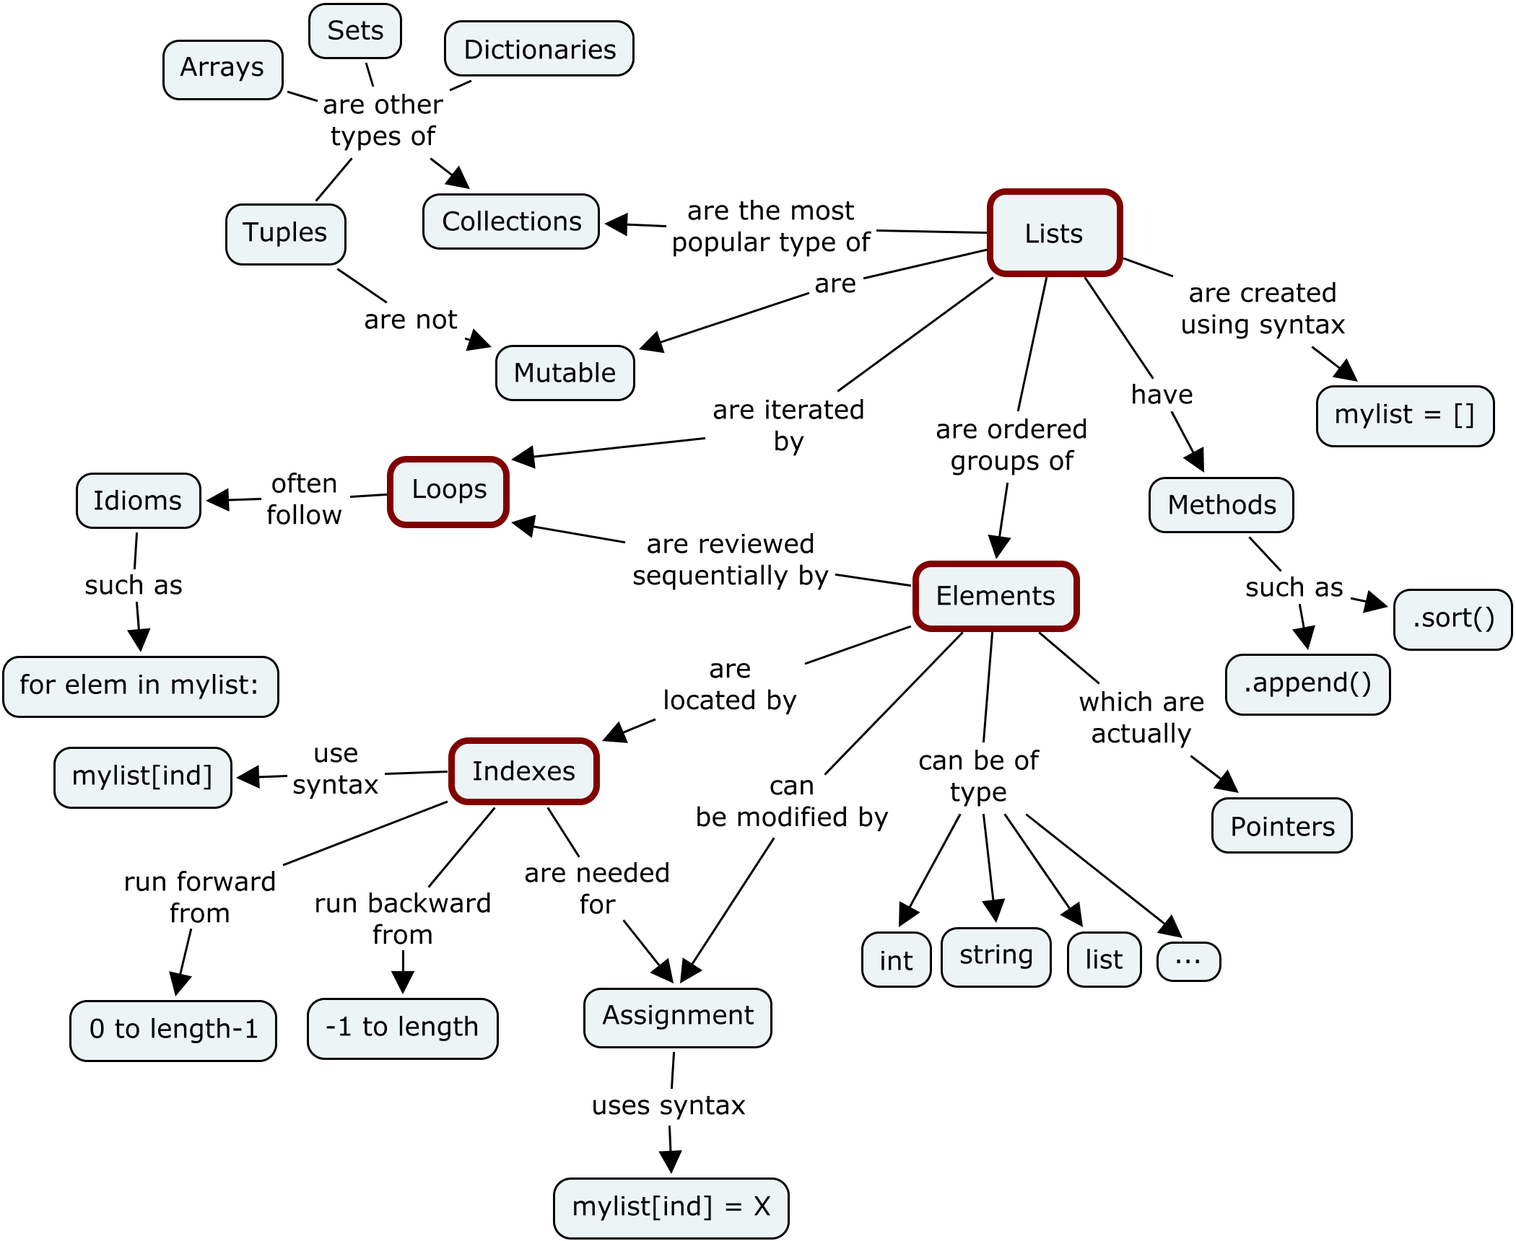

Slide 31
Mutable and Immutable in Python
b = []
print(id(b))
140675605442000
b.append(3)
print(b)
[3]
print(id(b))
140675605442000 # SAME
a = 4
print(id(a))
6406872
a = a + 1
print(id(a))
6406899 # DIFFERENT

Slide 32
Standard Data Types
Strings
Python strings cannot be changed — they are immutable.
Therefore, assigning to an indexed position in the string results in an error
I.e. str[0] = ‘J’ results in an error. However, str=“welcome” works.

Slide 33
Standard Data Types
List
A list contains items separated by commas and enclosed within square brackets ([]).
To some extent, lists are similar to arrays in C. One difference between them is that all the items belonging to a list can be of different data type.
The values stored in a list can be accessed using the slice operator ([ ] and [:]) with indexes starting at 0 in the beginning of the list and working their way from -1 at the end.
The plus (+) sign is the list concatenation operator, and the asterisk (*) is the repetition operator.
Unlike strings, which are immutable, lists are a mutable type, i.e. it is possible to change their content.
Trying to access/assign elements beyond the length of the list results in an error.

Slide 34
Standard Data Types
List (see the juypter notebook)
list = [ 'abcd', 786 , 2.23, 'john', 70.2 ]
tinylist = [123, 'john']
print (list) # Prints complete list
print (list[0]) # Prints first element of the list
print (list[1:3]) # Prints elements from 2nd till 3rd
print (list[2:]) # Prints elements from 3rd element
print (tinylist * 2) # Prints list two times
print (list + tinylist) # Prints concatenated lists
This produce the following result −
['abcd', 786, 2.23, 'john', 70.2]
abcd
[786, 2.23]
[2.23, 'john', 70.2]
[123, 'john', 123, 'john']
['abcd', 786, 2.23, 'john', 70.2, 123, 'john']

Slide 35
Standard Data Types
list = [ 'abcd', 786 , 2.23, 'john', 70.2 ]
tinylist = [123, 'john']
print (list) # Prints complete list
print (list[0]) # Prints first element of the list
print (list[1:3]) # Prints elements from 2nd till 3rd
print (list[2:]) # Prints elements from 3rd element
print (tinylist * 2) # Prints list two times
print (list + tinylist) # Prints concatenated lists
This produce the following result −
['abcd', 786, 2.23, 'john', 70.2]
abcd
[786, 2.23]
[2.23, 'john', 70.2]
[123, 'john', 123, 'john']
['abcd', 786, 2.23, 'john', 70.2, 123, 'john']

Slide 36
Standard Data Types
Tuples
A tuple is another sequence data type that is similar to the list.
A tuple consists of a number of values separated by commas.
Unlike lists, however, tuples are enclosed within parentheses.
The main differences between lists and tuples are: Lists are enclosed in brackets ( [ ] ) and their elements and size can be changed, while tuples are enclosed in parentheses ( ( ) ) and cannot be updated.
Tuples can be thought of as read-only lists/immutable lists.

Slide 37
Standard Data Types
Tuples
tuple = ( 'abcd', 786 , 2.23, 'john', 70.2 )
tinytuple = (123, 'john')
print (tuple) # Prints complete tuple
print (tuple[0]) # Prints first element of the tuple
print (tuple[1:3]) # Prints elements starting from 2nd till 3rd
print (tuple[2:]) # Prints elements starting from 3rd element
print (tinytuple * 2) # Prints tuple two times
print (tuple + tinytuple) # Prints concatenated tuple
This produce the following result −
('abcd', 786, 2.23, 'john', 70.2)
abcd
(786, 2.23)
(2.23, 'john', 70.2)
(123, 'john', 123, 'john')
('abcd', 786, 2.23, 'john', 70.2, 123, 'john')

Slide 38
Standard Data Types
Tuples and List
tuple = ( 'abcd', 786 , 2.23, 'john', 70.2 )
list = [ 'abcd', 786 , 2.23, 'john', 70.2 ]
tuple[2] = 1000 # Invalid syntax with tuple
list[2] = 1000 # Valid syntax with list

Slide 39
Standard Data Types
Sets
A set in Mathematics refers to an unordered collection of objects without any duplicate.
An object of type set may be created by enclosing the elements of the sets with in curly brackets.
The major difference is that sets, unlike lists or tuples, cannot have multiple occurrences of the same element and store unordered values.
The set objects may also created by applying the set function to lists strings and tuples.
Unlike lists we can’t access the elements of a set through indexing and slicing
We cant apply + and * operators on sets
Open the jupyter notebook

Slide 40
Standard Data Types
Dictionary
Dictionaries consist of key-value pairs.
A dictionary key can be almost any Python type, but are usually numbers or strings.
Values, on the other hand, can be any arbitrary Python object.
Dictionaries are enclosed by curly braces ({ }) and values can be assigned and accessed using square braces ([]).
Dictionaries have no concept of order among elements.
It is incorrect to say that the elements are "out of order"; they are simply unordered.
Dictionaries are mutable.

Slide 41
Standard Data Types
Dictionary
dict = {}
dict['one'] = "This is one"
dict[2] = "This is two"
tinydict = {'name': 'john','code':6734, 'dept': 'sales'}
print (dict['one']) # Prints value for 'one' key
print (dict[2]) # Prints value for 2 key
print (tinydict) # Prints complete dictionary
print (tinydict.keys()) # Prints all the keys
print (tinydict.values()) # Prints all the values
This produce the following result −
This is one
This is two
{'dept': 'sales', 'code': 6734, 'name': 'john'}
['dept', 'code', 'name']
['sales', 6734, 'john']

Slide 42
Input Statement
a=input(“Enter a:”)
a=int(input(“Enter a:”))
a=eval(input("Enter three values:"))
a, b, c=eval(input(“Enter a, b, c:”))

Slide 43
Matrices
Matrix is a two-dimensional data structure
All matrices can be considered as nested list
a=[[1,2,3],[4,5,6]]
a[0], a[1], a[0][0], a[0][2], a[1][2]
Eg.
a = [['Vijay',80,75,85,90,95],
['Vishal',75,80,75,85,100],
['Priyank',80,80,80,90,95]]
print(a[0]) # ['Vijay', 80, 75, 85, 90, 95]
print(a[0][1]) # 80
print(a[1][2]) # 80

Slide 44
Basic Operators
Types of Operator
Arithmetic Operators
Comparison (Relational) Operators
Assignment Operators
Logical Operators
Bitwise Operators
Membership Operators
Identity Operators

Slide 45
Basic Operators
Arithmetic Operators
Assume variable a holds 10 and variable b holds 21, then
Operator | Description | Example
+ Addition | Adds values on either side of the operator. | a + b = 31
- Subtraction | Subtracts right hand operand from left hand operand. | a – b = -11
* Multiplication | Multiplies values on either side of the operator | a * b = 210
/ Division | Divides left hand operand by right hand operand | b / a = 2.1
% Modulus | Divides left hand operand by right hand operand and returns remainder | b % a = 1
** Exponent | Performs exponential (power) calculation on operators | a**b =10 to the power 21
// | Floor Division - The division of operands where the result is the quotient in which the digits after the decimal point are removed. But if one of the operands is negative, the result is floored, i.e., rounded away from zero (towards negative infinity): | 9//2 = 4 and 9.0//2.0 = 4.0

Slide 46
Basic Operators
Comparison Operators
Assume variable a holds 10 and variable b holds 20, then
Operator | Description | Example
== | If the values of two operands are equal, then the condition becomes true. | (a == b) is not true.
!= | If values of two operands are not equal, then condition becomes true. | (a!= b) is true.
> | If the value of left operand is greater than the value of right operand, then condition becomes true. | (a > b) is not true.
< | If the value of left operand is less than the value of right operand, then condition becomes true. | (a < b) is true.
>= | If the value of left operand is greater than or equal to the value of right operand, then condition becomes true. | (a >= b) is not true.
<= | If the value of left operand is less than or equal to the value of right operand, then condition becomes true. | (a <= b) is true.

Slide 47
Basic Operators
Assignment Operators
Assume variable a holds 10 and variable b holds 20, then
Operator | Description | Example
= | Assigns values from right side operands to left side operand | c = a + b assigns value of a + b into c
+= | It adds right operand to the left operand and assign the result to left operand | c += a is equivalent to c = c + a
-= | It subtracts right operand from the left operand and assign the result to left operand | c -= a is equivalent to c = c - a
*= | It multiplies right operand with the left operand and assign the result to left operand | c *= a is equivalent to c = c * a
/= | It divides left operand with the right operand and assign the result to left operand | c /= a is equivalent to c = c / a
%= | It takes modulus using two operands and assign the result to left operand | c %= a is equivalent to c = c % a
**= | Performs exponential (power) calculation on operators and assign value to the left operand | c **= a is equivalent to c = c ** a
//= | It performs floor division on operators and assign value to the left operand | c //= a is equivalent to c = c // a

Slide 48
Basic Operators
Bitwise Operators
Assume a = 60 = 0b00111100 and b = 13 = 0b00001101, then
Operator | Description | Example
& | Operator copies a bit to the result if it exists in both operands | (a & b) (means 0000 1100)
| | It copies a bit if it exists in either operand. | (a | b) = 61 (means 0011 1101)
^ | It copies the bit if it is set in one operand but not both. | (a ^ b) = 49 (means 0011 0001)
~ | It is unary and has the effect of 'flipping' bits. | (~a ) = -61 (means 1100 0011 in 2's complement form due to a signed binary number.
<< | The left operands value is moved left by the number of bits specified by the right operand. | a << = 2 (means 1111 0000)
>> | The left operands value is moved right by the number of bits specified by the right operand. | a >> = 2 (means 0000 1111)

Slide 49
Basic Operators
Logical Operators
Assume a = True (Case Sensitive) and b = False (Case Sensitive), then
Operator | Description | Example
and | If both the operands are true then condition becomes true. | (a and b) is False.
or | If any of the two operands are non-zero then condition becomes true. | (a or b) is True.
not | Used to reverse the logical state of its operand. | Not(a and b) is True.

Slide 50
Basic Operators
Membership Operators
Python’s membership operators test for membership in a sequence, such as strings, lists, or tuples.
There are two membership operators as explained below
Eg.
list1=[1,2,3,4,5]
list2=[6,7,8,9]
for item in list1:
if item in list2:
print("overlapping")
else:
print("not overlapping")
Operator | Description | Example
in | Evaluates to true if it finds a variable in the specified sequence and false otherwise. | x in y, here “in” results in a 1 if x is a member of sequence y.
not in | Evaluates to true if it does not finds a variable in the specified sequence and false otherwise. | x not in y, here “not in” results in a 1 if x is not a member of sequence y.

Slide 51
Basic Operators
Identity Operators
Identity operators compare the memory locations of two objects.
There are two Identity operators explained below:
# Python program to illustrate the use
# of 'is' identity operator
x = 5
if (type(x) is int):
print ("true")
else:
print ("false")
Operator | Description | Example
is | Evaluates to true if the variables on either side of the operator point to the same object and false otherwise. | x is y, here ”is” results in 1 if id(x) equals id(y).
is not | Evaluates to false if the variables on either side of the operator point to the same object and true otherwise. | x is not y, here ”is not” results in 1 if id(x) is not equal to id(y).

Slide 52
Basic Operators
Python Operator Precedence
Operator | Description
** | Exponentiation (raise to the power)
~ + - | Complement, unary plus and minus
* / % // | Multiply, divide, modulo and floor division
+ - | Addition and subtraction
>> << | Right and left bitwise shift
& | Bitwise 'AND'
^ | | Bitwise exclusive `OR' and regular `OR'
<= < > >= | Comparison operators
<> == != | Equality operators
= %= /= //= -= += *= **= | Assignment operators
is is not | Identity operators
in not in | Membership operators
not or and | Logical operators

Slide 53
Decision Making
Simple if
if expression:
statement(s)
var1 = 100
if var1:
print ("1 - Got a true expression value")
print (var1)
var2 = 0
if var2:
print ("2 - Got a true expression value")
print (var2)
print ("Good bye!")
Output:
1 - Got a true expression value
100
Good bye!

Slide 54
Decision Making
if else
if expression:
statement(s)
else:
statement(s)
amount=int(input(“Enter amount: “))
if amount<1000:
discount=amount*0.05
print ("Discount",discount)
else:
discount=amount*0.10
print ("Discount",discount)
print ("Net payable:",amount-discount)

Slide 55
Decision Making
if else
Output:
Enter amount: 600
Discount 30.0
Net payable: 570.0
Enter amount: 1200
Discount 120.0
Net payable: 1080.0

Slide 56
Decision Making
elif Statement
if expression1:
statement(s)
elif expression2:
statement(s)
elif expression3:
statement(s)
else:
statement(s)

Slide 57
Decision Making
elif Statement
amount=int(input("Enter amount: "))
if amount<1000:
discount=amount*0.05
print ("Discount",discount)
elif amount<5000:
discount=amount*0.10
print ("Discount",discount)
else:
discount=amount*0.15
print ("Discount",discount)
print ("Net payable:",amount-discount)

Slide 58
Decision Making
elif Statement
Enter amount: 600
Discount 30.0
Net payable: 570.0
Enter amount: 3000
Discount 300.0
Net payable: 2700.0
Enter amount: 6000
Discount 900.0
Net payable: 5100.0

Slide 59
Decision Making
Nested if
if expression1:
statement(s)
if expression2:
statement(s)
elif expression3:
statement(s)
else:
statement(s)
elif expression4:
statement(s)
else:
statement(s)

Slide 60
Decision Making
Nested if
num=int(input("enter number"))
if num%2==0:
if num%3==0:
print("Divisible by 3 and 2")
else:
print("divisible by 2 not divisible by 3")
else:
if num%3==0:
print("divisible by 3 not divisible by 2")
else:
print("not Divisible by 2 not divisible by 3")

Slide 61
Loops
While Loop
while expression:
statement(s)
count = 0
while count < 9:
print ('The count is:', count)
count = count + 1
print("Good bye!")

Slide 62
Loops
While Loop
The count is: 0
The count is: 1
The count is: 2
The count is: 3
The count is: 4
The count is: 5
The count is: 6
The count is: 7
The count is: 8
Good bye!

Slide 63
Loops
for loop
for iterating_var in sequence:
statements(s)
for var in list(range(5)):
print (var)
Output:
0
1
2
3
4

Slide 64
Loops
for Loop
for letter in 'Python': # traversal of a string sequence
print ('Current Letter :', letter)
Output:
Current Letter : P
Current Letter : y
Current Letter : t
Current Letter : h
Current Letter : o
Current Letter : n

Slide 65
Loops
for Loop
fruits = ['banana', 'apple', 'mango']
for fruit in fruits: #traversal of List sequence
print ('Current fruit :', fruit)
print ("Good bye!")
Output:
Current fruit : banana
Current fruit : apple
Current fruit : mango
Good bye!

Slide 66
Loops
for Loop
Iterating by Sequence Index
fruits = ['banana', 'apple', 'mango']
for index in range(len(fruits)):
print('Current fruit :', fruits[index])
print ("Good bye!")
Output:
Current fruit : banana
Current fruit : apple
Current fruit : mango
Good bye!

Slide 67
Loops
Break Statement
for letter in 'Python':
if letter == 'h':
break
print ('Current Letter :', letter)
print ('Breaked Letter :', letter)
Output:
Current Letter : P
Current Letter : y
Current Letter : t
Breaked Letter : h

Slide 68
Loops
Continue Statement
for letter in 'Python':
if letter == 'h':
continue
print ('Current Letter :', letter)
Output:
Current Letter : P
Current Letter : y
Current Letter : t
Current Letter : o
Current Letter : n

Slide 69
Loops
Using else Statement with Loops
Python supports to have an else statement associated with a loop statement
If the else statement is used with a for loop, the else block is executed only if for loops terminates normally (and not by encountering break statement)
If the else statement is used with a while loop, the else statement is executed when the condition becomes false.

Slide 70
Loops
Using else Statement with Loops
numbers = [11, 33, 55, 39, 55, 76, 37, 21, 23, 41, 13]
for num in numbers:
if num%2==0:
print('the list contains an even number')
break
else:
print('the list does not contain even number')
Output:
the list contains an even number

Slide 71
Loops
Using else Statement with Loops
num=0
while num < 10:
num=num+1
if num%2==0:
print('In side the loop', num)
break
else:
print ('Outside the loop in else')
Output:
In side the loop 2

Slide 72
Numbers - Revisited
Number Type Conversion
Type int(x) to convert x to a plain integer.
Type float(x) to convert x to a floating-point number.
Type complex(x) to convert x to a complex number with real part x and imaginary part zero.
Type complex(x, y) to convert x and y to a complex number with real part x and imaginary part y. x and y are numeric expressions.

Slide 73
Numbers - Revisited
Numbers
Mathematical Functions
Need to import math
import math
num=-6.1
print(math.ceil(num))
Function | Returns ( description )
abs(x) | The absolute value of x: the (positive) distance between x and zero.
math.ceil(x) | The ceiling of x: the smallest integer not less than x
math.floor(x) | The floor of x: the largest integer not greater than x
math.exp(x) | The exponential of x: e^{x}
math.log(x) | The natural logarithm of x, for x> 0
math.log10(x) | The base-10 logarithm of x for x> 0 .

Slide 74
Numbers - Revisited
Numbers
Mathematical Functions
Function | Returns ( description )
max(x1, x2,...) | The largest of its arguments: the value closest to positive infinity
min(x1, x2,...) | The smallest of its arguments: the value closest to negative infinity
pow(x, y) | The value of x**y.
round(x ,n) | x rounded to n digits from the decimal point.
math.sqrt(x) | The square root of x for x > 0

Slide 75
Numbers - Revisited
Numbers
Random Number Functions
Function | Description
random.choice(seq) | A random item from a list, tuple, or string.
random.random() | A random float r, such that 0 is less than or equal to r and r is less than 1
random.seed([x]) | Sets the integer starting value used in generating random numbers. Call this function before calling any other random module function. Returns None.
random.shuffle(lst) | Randomizes the items of a list in place. Returns None.
random.uniform(x, y) | A random float r, such that r is less than or equal to x and r is less than y
random.randint(x, y) | Return random integer in range [x, y], including both end points
random.sample(population, k) | Chooses k unique random elements from a population sequence or set.

Slide 76
Numbers - Revisited
Random Number Functions
import random
myList = [2, 109, False, 10, "Vijay", 482, "Vishal"]
print(random.randint(0, 100))
print(random.random() * 100)
print(random.choice(myList))
print(random.randrange(0, 101, 5))
print(random.uniform(0, 100))
print(myList)
random.shuffle(myList)
print(myList)
Output
39
45.26060117036571
Vijay
40
84.56477617706464
[2, 109, False, 10, 'Vijay', 482, 'Vishal']
[482, 2, 'Vishal', 'Vijay', 109, 10, False]

Slide 77
Strings - Revisited
Strings (Assume str to be a string variable)
Sr. No. | Methods with Description
1 | str.capitalize() Capitalizes first letter of string.
2 | str.isalnum() Returns true if string has at least 1 character and all characters are alphanumeric and false otherwise.
3 | str.isalpha() Returns true if string has at least 1 character and all characters are alphabetic and false otherwise.
4 | str.isdigit() Returns true if string has at least 1 character and contains only digits and false otherwise.
5 | str.islower() Returns true if string has at least 1 cased character and all cased characters are in lowercase and false otherwise.
6 | str.isspace() Returns true if string contains only whitespace characters and false otherwise.

Slide 78
Strings - Revisited
Strings
Sr. No. | Methods with Description
7 | str.isupper() Returns true if string has at least one cased character and all cased characters are in uppercase and false otherwise.
8 | len(str) Returns the length of the string
9 | str.lower() Converts all uppercase letters in string to lowercase.
10 | max(str) Returns the max alphabetical character from the string str.
11 | min(str) Returns the min alphabetical character from the string str.
12 | str.upper() Converts lowercase letters in string to uppercase.

Slide 79
Lists - Revisited
Delete List Elements
list = ['physics', 'chemistry', 1997, 2000]
print (list)
del list[2]
print ("After deleting value at index 2 : ", list)
Output:
['physics', 'chemistry', 1997, 2000]
After deleting value at index 2 : ['physics', 'chemistry', 2000]

Slide 80
Lists - Revisited
Basic List Operations
Python Expression | Results | Description
len([1, 2, 3]) | 3 | Length
[1, 2, 3] + [4, 5, 6] | [1, 2, 3, 4, 5, 6] | Concatenation
['Hi!'] * 4 | ['Hi!', 'Hi!', 'Hi!', 'Hi!'] | Repetition
3 in [1, 2, 3] | True | Membership
for x in [1,2,3] : print (x,end=' ') | 1 2 3 | Iteration

Slide 81
Lists - Revisited
Built in List Functions and Methods (assume list to be name of the variable)
Sr. | Function with Description
1 | len(list) Gives the total length of the list.
2 | max(list) Returns item from the list with max value.
3 | min(list) Returns item from the list with min value.
4 | list.copy() Returns a copy of the list

Slide 82
Lists - Revisited
List Methods
SN | Methods with Description
1 | list.append(obj) Appends object obj to list. Returns None.
2 | list.count(obj) Returns count of how many times obj occurs in list
3 | list.index(obj) Returns the lowest index in list that obj appears
4 | list.insert(index, obj) Inserts object obj into list at offset index
5 | list.pop() Removes and returns last object or obj from list
6 | list.remove(obj) Removes first instance of obj from list
7 | list.reverse() Reverses objects of list in place
8 | list.sort() Sorts objects of list in place

Slide 83
Python Functions
Defining a Function
def functionname( parameters ):
"function_docstring"
function_suite
return [expression]
def printme( str ):
"This prints a passed string into this function"
print (str)
return

Slide 84
Python Functions
Pass by reference vs value
All parameters (arguments) in the Python language are passed by reference.
It means if you change what a parameter refers to within a function, the change also reflects back in the calling function.

Slide 85
Python Functions
Pass by reference vs value
myList = [2, 109, False, 10, "Vijay", 482, "Vishal"]
print(myList)
# Function definition is here
def changeme( mylist ):
"This changes the passed list into this function"
print("Values inside the function before change: ", mylist)
mylist[2]=50
print("Values inside the function after change: ", mylist)
return
changeme(myList)
Output:
[2, 109, False, 10, 'Vijay', 482, 'Vishal']
Values inside the function before change: [2, 109, False, 10, 'Vijay', 482, 'Vishal']
Values inside the function after change: [2, 109, 50, 10, 'Vijay', 482, 'Vishal']

Slide 86
Python Functions
Pass by reference vs value
#Function definition is here
def changeme( mylist ):
'''This changes a passed list into this function'''
mylist = [1,2,3,4] #Assign new reference in mylist
print ("Values inside the function: ", mylist)
return
# Now you can call changeme function
mylist = [10,20,30]
changeme( mylist)
print ("Values outside the function: ", mylist)
Output:
Values inside the function: [1, 2, 3, 4]
Values outside the function: [10, 20, 30]

Slide 87
Python Functions
Global vs. Local Variables
Variables that are defined inside a function body have a local scope, and those defined outside have a global scope.
This means that local variables can be accessed only inside the function in which they are declared, whereas global variables can be accessed throughout the program body by all functions.

Slide 88
Python Functions
Global vs. Local Variables
total = 0 # This is a global variable.
# Function definition is here
def sum( arg1, arg2 ):
# Add both the parameters and return them."
total = arg1 + arg2; # Here total is local variable.
print ("Inside the function local total : ", total)
return
# Now you can call sum function
sum(10, 20)
print ("Outside the function global total : ", total )
Output:
Inside the function local total : 30
Outside the function global total : 0

Slide 89
Python Functions
Global vs. Local Variables
total = 0 # This is global variable.
# Function definition is here
def sum( arg1, arg2 ):
# Add both the parameters and return them."
global total
total = arg1 + arg2;
print ("Inside the function local total : ", total)
return
# Now you can call sum function
sum( 10, 20 )
print ("Outside the function global total : ", total )
Output:
Inside the function local total : 30
Outside the function global total : 30
Note: You can also return multiple values, e.g. return x, y

Slide 90
Python Functions
Multiple return values
# This function returns a tuple
def fun():
str = "Python is Great"
x = 100
return str, x; # Return tuple, we could also
# write (str, x)
#Call the function now
str, x = fun() # Assign returned tuple
print(str)
print(x)
Output:
Python is Great
100

Slide 91
Miscellaneous
del var_name
del var1, var2
type(5)
type(5.6)
type(5+2j)
type(“hello”)
type([‘h’,’e’])
type((‘h’,’e’))
Multiple Assignments
a = b = c = 1
a, b, c = 1, 2, "john"

Slide 92
Python Input / Output
Printing to screen using print statement
print ("Python is great”)
Reading keyboard input
raw_input() - discontinued in version 3
The raw_input([prompt]) function reads one line from standard input and returns it as a string
str = raw_input("Enter your input: ")
print("Received input is : ", str)
input()
The input([prompt]) function is equivalent to raw_input, except that it assumes the input is a valid Python expression and returns the evaluated result to you.
str = input("Enter your input: ");
print "Received input is : ", str
Output:
Enter your input: [x*5 for x in range(2,10,2)]
Recieved input is : [10, 20, 30, 40]

Slide 93
File Input / Output
Open File
file_obj = open(file_name [, access_mode][, buffering])
file_name − The file_name argument is a string value that contains the name of the file that you want to access
access_mode − The access_mode determines the mode in which the file has to be opened, i.e., read, write, append, etc. This is optional parameter and the default file access mode is read (r).
buffering − If the buffering value is set to 0, no buffering takes place. If the buffering value is 1, line buffering is performed while accessing a file.

Slide 94
File Input / Output
Mode | Description
r | Opens a file for reading only. The file pointer is placed at the beginning of the file. This is the default mode
rb | Opens a file for reading only in binary format
r+ | Opens a file for both reading and writing
rb+ | Opens a file for both reading and writing in binary format
w | Opens a file for writing only. Overwrites the file if the file exists. If the file does not exist, creates a new file for writing
wb | Opens a file for writing only in binary format
w+ | Opens a file for both writing and reading
wb+ | Opens a file for both writing and reading in binary format
a | Opens a file for appending. The file pointer is at the end of the file if the file exists. That is, the file is in the append mode. If the file does not exist, it creates a new file for writing
ab | Opens a file for appending in binary format
a+ | Opens a file for both appending and reading
ab+ | Opens a file for both appending and reading in binary format

Slide 95
File Input / Output
Once a file is opened with open function, many atrributes of the file can be accessed with file_object
# Open a file
fo = open("test.txt", "wb")
print("Name of the file: ", fo.name)
print("Closed or not : ", fo.closed)
print("Opening mode : ", fo.mode)
print("Softspace flag : ", fo.softspace)
Output
Name of the file: test.txt
Closed or not : False
Opening mode : wb
Softspace flag : 0
Close the file using file_object.close() method
Attribute | Description
file.closed | Returns true if file is closed, false otherwise.
file.mode | Returns access mode with which file was opened.
file.name | Returns name of the file
file.softspace | Returns false if space explicitly required with print, true otherwise

Slide 96
File Reading / Writing
The file_object provides access methods to access the file
write() Method
The write() method writes any string to an open file
#Open a file
fo = open("test.txt", "w")
fo.write("Python is a great. \nYeah its great!!\n");
#Close opened file
fo.close()

Slide 97
File Reading / Writing
read() Method
The read() method reads a string from an open file
# Open a file
fo = open("test.txt", "r+")
str = fo.read(10);
print("Read String is : ", str)
# Close opend file
fo.close()
Output
Read String is : Python is

Slide 98
File Position
tell() Method
The tell() method tells you the current position within the file
The seek(offset[, from]) method changes the current file position. The offset argument indicates the number of bytes to be moved. The from argument specifies the reference position from where the bytes are to be moved.
from: 0 - means beginning of file
from: 1 - current position as reference point
from: 2 - end of the file as reference point

Slide 99
File Position
# Open a file
fo = open("test.txt", "r+")
str = fo.read(10);
print("Read String is : ", str)
# Check current position
position = fo.tell();
print("Current file position : ", position)
# Reposition pointer at the beginning once again
position = fo.seek(0, 0);
str = fo.read(10);
print("Again read String is : ", str)
# Close opend file
fo.close()
Output
Read String is : Python is
Current file position : 10
Again read String is : Python is

Slide 100
Python Modules
Module allows to logically organize the Python code
Eg. Create a hello.py file with following contents
def say_hello( par ):
print "Hello : ", par
return
import statement
A module is loaded only once, regardless of the number of times it is imported
Output
# Import module hello
import hello
# Call defined function from module as follows
hello.say_hello("Vijay")

Slide 101
NumPy

Slide 102
Numpy
Numpy (Numeric/Numerical Python)
Numpy is an open-source add-on module that provides common mathematical and numerical routines as pre-compiled fast functions
It provides basic routines for manipulating large arrays and matrices of numeric data.
Install
C:\\Python34\scripts>pip3.4 list
C:\\Python34\scripts>pip3.4 install numpy
Already installed with Anaconda. If not, use conda install numpy
import numpy as np

Slide 103
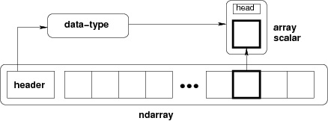
Numpy
NumPy has an N-dimensional array type called ndarray
Every item in an ndarray takes the same size of block in the memory. Each element in ndarray is an object of data-type object (called dtype).
To create an ndarray
numpy.array(object, dtype = None, copy = True, order = None, subok = False, ndmin = 0)

Slide 104
Numpy
To create an array
import numpy as np
a = np.array([1,2,3])
print a
Output
[1 2 3]
To create multi-dimensional array
a = np.array([[1,2,3],[4,5,6]])
print a
Output
[[1 2 3]
[4 5 6]]
To create array with minimum dimension
a = np.array([1, 2, 3, 4, 5], ndmin = 2)
print a
Output
[[1 2 3 4 5]]

Slide 105
Numpy
To create an array with dtype parameter
a = np.array([1, 2, 3], dtype = complex)
print a
Output
[ 1.+0.j, 2.+0.j, 3.+0.j]
a = np.array([[1, 2, 3], [4, 5, 6]], float)
print a
Output
[[1. 2. 3.]
[4. 5. 6.]]

Slide 106
Numpy - datatypes (dtypes)
NumPy supports a much greater variety of numerical types than Python does.
bool_, int8, int16, int32, int64, uint8, uint16, uint32, uint64, float16, float32, float64, complex64, complex128 etc...
A dtype object is constructed using the following syntax :
numpy.dtype(object, align, copy)
dt = np.dtype([('name','S20'),('no',np.int16)])
a = np.array([('VU',4),('ViyU',20),('PU',3)],dtype = dt)
print (a)
student = np.dtype([('name','S20'), ('age', 'i1'), ('marks', 'f4')])
a = np.array([('abc', 21, 50),('xyz', 18, 75)], dtype = student)
print(a)
print(a[])

Slide 107
Numpy
np.array
Two dimensional array

Slide 108
Numpy
np.array
Two dimensional array: reshape() & copy()
Strange - Shape is a settable property and it is a tuple and you can concatenate the dimension.

Slide 109
Numpy
np.array
Two dimensional array: reshape(), transpose() & flatten()

Slide 110
Numpy
np.array
Two dimensional array: concatenate()

Slide 111
Numpy
np.array
Two dimensional array: concatenate()

Slide 112
Numpy
np.array
Other ways to create array

Slide 113
Numpy
np.array
Array mathematics

Slide 114
Numpy
np.array
Array mathematics

Slide 115
Numpy
np.array
Array mathematics - Broadcasting

Slide 116
Numpy
np.array
Array mathematics - Broadcasting

Slide 117
Numpy
np.array
Array mathematics

Slide 118
Numpy
np.array
Array mathematics

Slide 119
Numpy
np.array
Array iteration

Slide 120
Numpy
np.array
Basic array operations
np.mean(a)
np.var(a)
np.std(a)
np.min(a)
np.max(a)
np.argmin(a)
np.argmax(a)
np.sort(a)

Slide 121
Numpy
np.array
Basic array operations
a=np.array([[1,2],[3,4]])
np.mean(a) #2.5
np.mean(a,axis=0) #array([ 2., 3.]) #column wise
np.mean(a,axis=1) #array([ 1.5, 3.5]) #row wise
b=np.array([[11,5,14],[2,5,1]])
np.sort(b) # array([[ 5, 11, 14],
[ 1, 2, 5]])
np.sort(b,axis=1) # array([[ 5, 11, 14],
[ 1, 2, 5]])
np.sort(b,axis=0) # array([[ 2, 5, 1],
[ 11, 5, 14]])
3-D Array
a=np.array([ [[11,5,14],[2,5,1]], [[11,5,14],[2,5,1]] ])

Slide 122
Numpy
np.array
Comparison Operators & Value Testing

Slide 123
Numpy
np.array
Comparison Operators & Value Testing

Slide 124
Numpy
np.array
Where Function

Slide 125
Numpy
np.array
Checking for NaN and Inf

Slide 126
Numpy
np.array
Array Item Selection & Manipulation

Slide 127
Numpy
np.array
Vector and Matrix Mathematics

Slide 128
Numpy
np.array
Vector and Matrix Mathematics

Slide 129
Numpy
np.array
Statistics

Slide 130
Numpy
np.array
Random Numbers

Slide 131
Numpy
np.array
Random Numbers

Slide 132
Python References
Enthought.com← Location of Enthought Canopy and Enthought Python Distribution
Docs.python.org <- A great resource for general Python
Docs.enthought.com <- Release notes, installation instructions for Enthought
Pyvideo.org <- a repository of links to videos on Python from all the python conferences
Training.enthought.com <- get a Enthought account from Bob get free TRAINING!
scipy-lectures.org <- Tutorials on the scientific Python ecosystem
awesome-python.com <- A curated list of awesome Python frameworks, libraries, software and resources
talkpython.fm <- talk python to me podcast
pythonbytes.fm <- very short and to the point weekly updates about python

